Slide 1
The Observer Pattern
CPSC 2150

Slide 2

Example
You’re writing a program that receives data from a network and performs various tasks when data is received (displays the message, sends response data, etc.). The tasks to be performed may change depending on the circumstances. How do you design object interactions to allow this flexibility?
Notes:
2

Slide 3
Example
You could come up with your own solution… but why reinvent the wheel?
You look up behavioral design patterns (interactions) and find the observer pattern!
Notes:
3

Slide 4
Terminology
We want to monitor the network for events
The machine on the network that has the event occur is the subject of the interaction
The objects in your program that need to do something in response to the events for a particular subject are called observers (or listeners) for that subject

Slide 5
Solution #1: Use Polling
subject
observer
The main program (the only observer) continually polls each possible subject to ask whether any events have occurred
This is considered cumbersome...
This is NOT the Observer pattern

Slide 6
Polling Pseudo-code
while (true) {
if (s₀ has experienced an event) {
if (event is e₀) {
respond to it
} else if (event is e₁) {
respond to it
} else ...
} else if (s₁ has experienced an event) {
...
}
}

Slide 7
Solution #2: Use Callbacks
event
subject
observer
Each observer (there may be many) registers its interest in a subject’s events, and then waits until the subject calls it back to tell it that there has been an event

Slide 8
Solution #2: Use Callbacks
But how? What does this mean?
event
subject
observer
Each observer (there may be many) registers its interest in a subject’s events, and then waits until the subject calls it back to tell it that there has been an event

Slide 9
The Observer Pattern
Each subject expects each observer (listener) to register itself with that subject if it is interested in the subject’s events
Each subject keeps track of its own set of interested observers
Whenever an event occurs, the subject invokes a specific callback method for each registered observer, passing an event argument that describes the event

Slide 10
The Observer Pattern
Each subject expects each observer (listener) to register itself with that subject if it is interested in the subject’s events
Each subject keeps track of its own set of interested observers
Whenever an event occurs, the subject invokes a specific callback method for each registered observer, passing an event argument that describes the event
Registering interest is done by calling a method of the subject; usually this is done once as part of set-up.

Slide 11
The Observer Pattern
The set of observers for a given subject can be kept in a Set variable, for example.
Each subject expects each observer (listener) to register itself with that subject if it is interested in the subject’s events
Each subject keeps track of its own set of interested observers
Whenever an event occurs, the subject invokes a specific callback method for each registered observer, passing an event argument that describes the event

Slide 12
The Observer Pattern
This method is described in an interface that any potential observer must implement.
Each subject expects each observer (listener) to register itself with that subject if it is interested in the subject’s events
Each subject keeps track of its own set of interested observers
Whenever an event occurs, the subject invokes a specific callback method for each registered observer, passing an event argument that describes the event

Slide 13
The Observer Pattern
Each subject expects each observer (listener) to register itself with that subject if it is interested in the subject’s events
Each subject keeps track of its own set of interested observers
Whenever an event occurs, the subject invokes a specific callback method for each registered observer, passing an event argument that describes the event
This is one of many object-oriented design patterns that address common OOP issues (often language deficiencies); most are considered best practices.

Slide 14
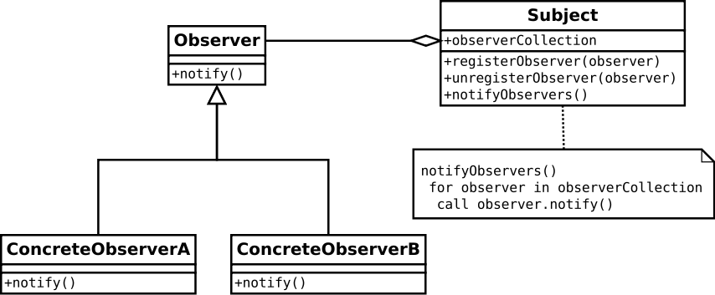
Observer Pattern
Notes:
14

Slide 15
The Observer Pattern
Another use is with Graphical User Interfaces.
Every “widget” on the screen is an object in the code
Buttons, textboxes, etc
We don’t know what widget the user will interact with next
The widgets are the subjects
We create an observer for them

Slide 16
The observer pattern and GUIs
Every widget on our screen becomes a subject
Implements some Subject interface
Every subject contains a set of interested observers
The observers will have to register with the subjects to be added to this list
Every subject must provide a method for observers to register (takes in an Observer object)
When someone interacts with the widget, it notifies it’s observers

Slide 17
The observer pattern and GUIs
Our Screen class will become the observer
Every widget on the screen is declared as a private variable of the screen itself
Now the screen can access all the widgets
The screen class needs to call the register method for each widget, and pass itself in.
The screen class will have to provide the call back method
The widget will call this method to let the screen know that the user interacted with it
In this method the screen decides how to react to someone interacting with that widget

Slide 18
Set Up by DemoGUI Constructor
resetButton
copyButton
(and
other
widgets)
this
(DemoGUI)

Slide 19
Set Up by DemoGUI Constructor
Before registration of this as an observer of the buttons.
resetButton
copyButton
(and
other
widgets)
this
(DemoGUI)

Slide 20
Set Up by DemoGUI Constructor
After registration of this as an observer of the buttons.
resetButton
copyButton
(and
other
widgets)
this
(DemoGUI)

